Slide 1
Woodland Public Schools
Facilities and Safety
January 2017 report

Slide 2
FACILITIES REPORT
ESD Online Employee Accident/ Incident Reporting
Woodland Schools has offered to beta test the new online Employee Accident Report system created by ESD 112. The new form is completed online and accessed through the District Safety tab on the website. This link also includes access to the accident investigation form required to be filled out for all employee accidents.
Senior Tile Stand WHS
You may have noticed a new concrete structure at the entrance to the woodland high school. The senior tile stand was installed last week to accommodate 10 years of inspiring messages from our graduating youth. The stand is approximately 3 feet tall, 2 feet deep, 10 feet long and has casted slots for the tiles. The stand will be loaded with the stones, and then removed each year for engraving.
Card Key System
Security system upgrades for WIS, WPS and WMS are moving forward at a good pace. Door controller panels were installed at the schools last week, and we have received the system software delivered to the IT department for installation on the Districts network. Over the next two weeks, the system badge printers and door hardware will be installed. Additionally, the system controllers will be connected to the network, and power will be connected.

Slide 3
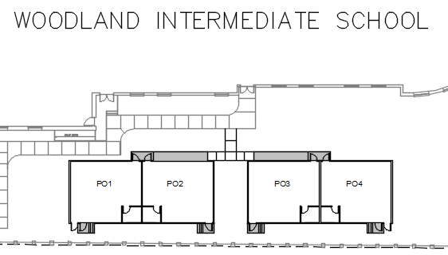
FACILITIES REPORT continued
Portable Install Woodland Intermediate School – Mechanical, electrical, foundation and site layout drawings were completed this last week. We are expecting to file building permits by the first week in March. A site walk-through and meeting was completed with the building manufacturer to shore up the logistics of moving the buildings into place. Additionally, a site walk through was completed with the Woodland Building and Planning Department, to ensure we will have no issues during the permitting process. The buildings are planned to be placed on the school grounds during the first week of summer.
Drawing showing the portables’ location on the south side of the school

Slide 4
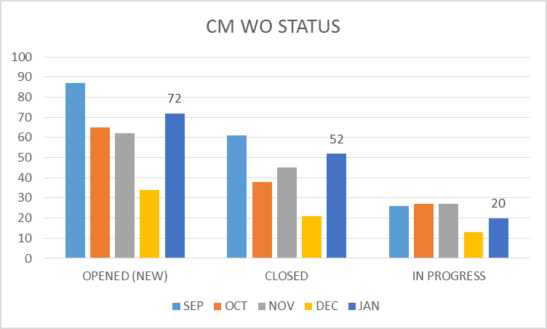
FACILITY CHARTS – POWER COST AND WORK ORDER STATUS

Slide 5
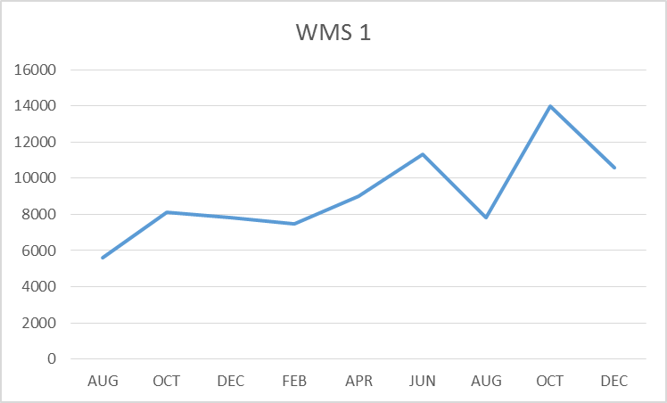
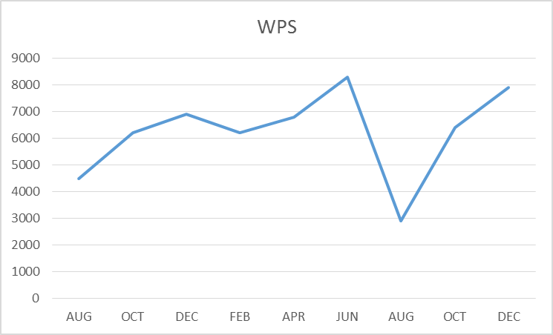
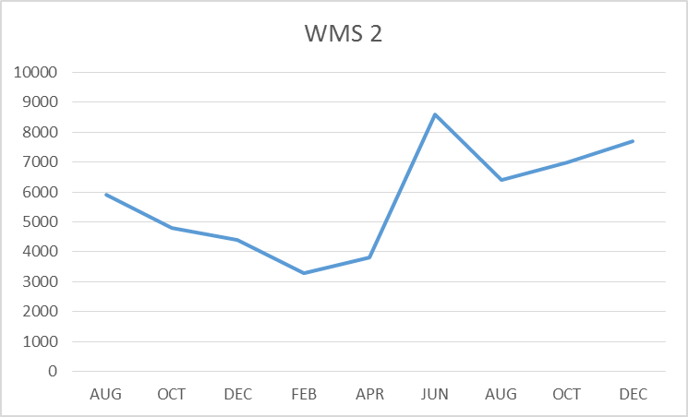
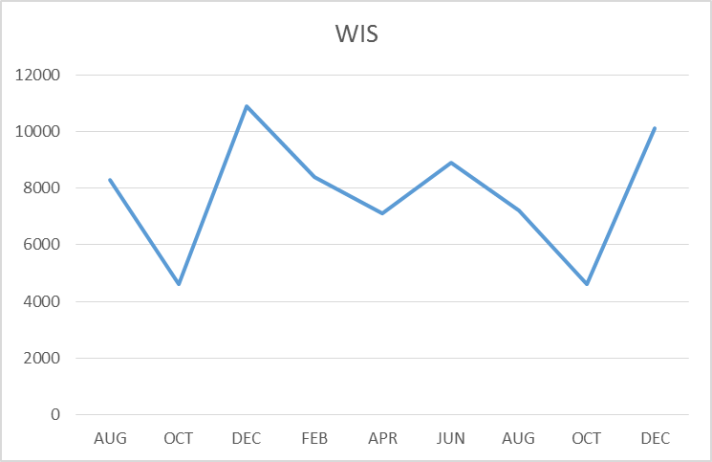
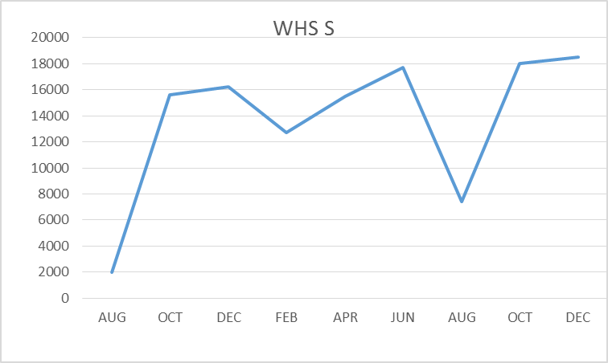
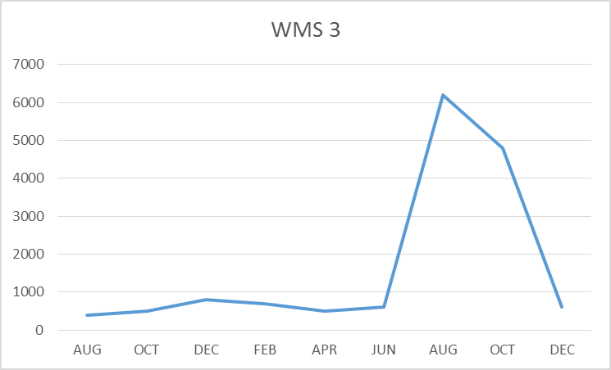
FACILITY CHARTS – WATER USAGE- WHS, WIS, WMS, WPS
Water billed every two months.
Next update will be in March
report for Jan and Feb Consumption

Slide 6
SAFETY
Accidents for the Month
There were a total of 17 injuries in the month of December-2 students and 15 staff members. A large spike in staff related incidents and accidents were noted at WPS.
Staff Accidents/Incidents (15)
WPS – Students kicked/punched IA’s multiple times (14 events with varying injuries).
WIS – Employee slipped on stair while cleaning
Student Accidents/Injuries (2)
WHS – Student hurt shoulder while wrestling.
WHS – Student ran into wall during practice game and injured head (concussion assessment completed)

Slide 7
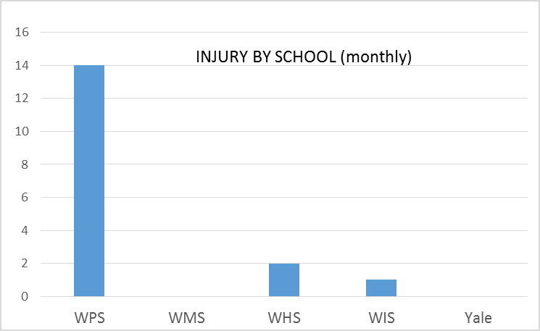
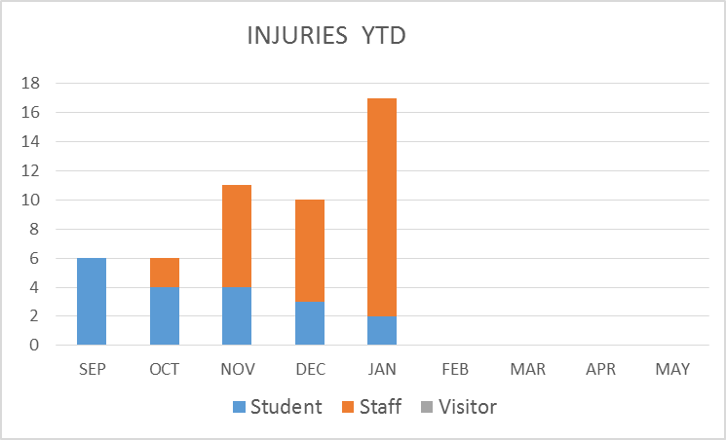
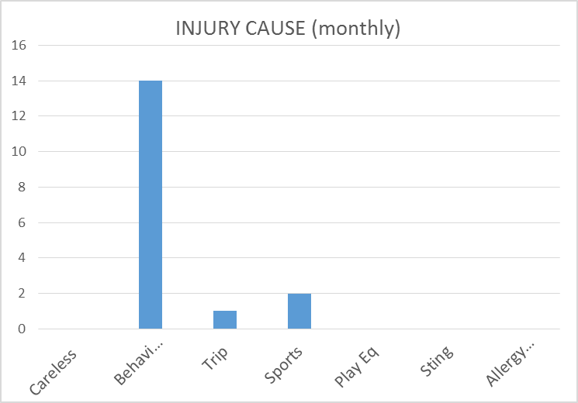
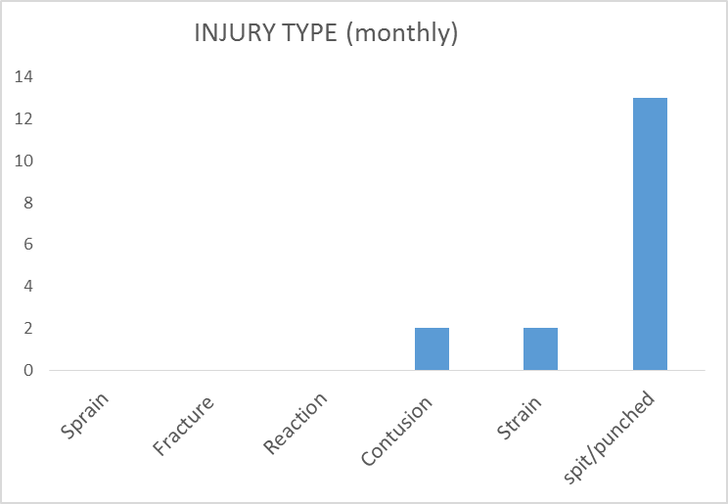
SAFETY CHARTS

